Slide 1
Transportation Problem
Huzefa Ayub
Roll-203034-11-0103
BSc Mathematics(Hons)
Semester 5

Slide 2
agenda
INTRODUCTION 3
TRANSPORTATION PROBLEM 4
HISTORY 7
USES 9
SUMMARY 10

Slide 3

introduction
The transportation problem in operational research is concerned with finding the minimum cost of transporting a single commodity from a given number of sources to a given number of destinations. These types of problems can be solved by general network methods
The data of the model include
The level of supply at each source and the amount of demand at each destination.
The unit transportation cost of the commodity from each source to each destination.
Since there is only one commodity, a destination can receive its demand from more than one source. The objective is to determine how much should be shipped from each source to each destination so as to minimize the total transportation cost.

Slide 4
REAL LIFE APPLICATION OF TRANSPORTATION PROBLEM IN MALAYSIAN PETROCHEMICAL COMPANY
 | D1 | D2 | D3 | D4 | D5 | Production capacity
P1 | 3 | 4 | 6 | 8 | 8 | 20
P2 | 2 | 10 | 0 | 5 | 8 | 30
P3 | 7 | 11 | 20 | 40 | 3 | 15
P4 | 1 | 0 | 9 | 14 | 16 | 30
Demand | 40 | 6 | 8 | 18 | 6
D1- China
D2- USA
D3- South Korea
D4- Germany
D5- India
The demand is not equal to the production capacity therefore the solution is not balanced. To balance the solution, we assume a dummy column D6 with a demand of 8. Now Demand = Production Capacity thus the solution is balanced.

Slide 5
Balanced TP
 | D1 | D2 | D3 | D4 | D5 | D6 | Production capacity
P1 | 3 | 4 | 6 | 8 | 8 | 0 | 20
P2 | 2 | 10 | 0 | 5 | 8 | 0 | 30
P3 | 7 | 11 | 20 | 40 | 3 | 0 | 15
P4 | 1 | 0 | 9 | 14 | 16 | 0 | 30
Demand | 40 | 6 | 8 | 18 | 6 | 8
Now we solve the balanced TP by Vogel’s approximation method to obtain the transportation cost.

Slide 6

 | D1 | D2 | D3 | D4 | D5 | D6 | Production | P1 | P2 | P3 | P4 | P5 | P6 | P7 | P8
O1 | 3 20 | 4 | 6 | 8 | 8 | 0 | 20 | 3 | 3 | 3 | 1 | 5 | 5 | 5 | -
O2 | 2 4 | 10 | 0 8 | 5 18 | 8 | 0 | 30 | 0 | 2 | 2 | 3 | 3 | 3 | 3 | 3
O3 | 7 1 | 11 | 20 | 40 | 3 6 | 0 8 | 15 | 3 | 3 | 7 | 4 | 33 | - | - | -
O4 | 1 24 | 0 6 | 9 | 14 | 16 | 0 | 30 | 0 | 0 | 0 | 1 | 13 | 13 | - | -
Demand | 40 | 6 | 8 | 18 | 6 | 8
P1 | 1 | 4 | 6 | 3 | 5 | 0
P2 | 1 | 4 | - | 3 | 5 | 0
P3 | 1 | 4 | - | 3 | - | 0
P4 | 1 | 4 | - | 3 | - | -
P5 | 1 | - | - | 3 | - | -
P6 | 1 | - | - | 3 | - | -
P7 | 1 | - | - | 3 | - | -
P8 | 2 | - | - | 5 | - | -
To find the optimal solution, we apply MODI method and find a set of numbers $u_{i}$(for rows) and $v_{j}$(for columns) for which $c_{ij}=u_{i}+v_{j}$ for occupied cells
$$u_{1}=1,u_{2}=0,u_{3}=5,u_{4}−1$$
$$v_{1}=2,v_{2}=1,v_{3}=0,v_{4}=5,v_{5}=−2,v_{6}=−5$$
We find $∆_{ij}=c_{ij}−(u_{i}−v_{j})$ for unoccupied cells
$∆_{12}=2,∆_{32}=5,∆_{33}=15,$ $∆_{14}=5,$ $∆_{22}=9,$ $∆_{13}=5$, $∆_{43}=10,$ $∆_{34}=30,$ $∆_{44}=10,$ $∆_{15}=9,$ $∆_{25}=10,$ $∆_{45}=19,$ $∆_{16}=4,$ $∆_{26}=5,$ $∆_{46}=6$
As all $∆_{ij}>0$, the solution is optimum and unique
Transportation Cost= $207$

Slide 7
History
In mathematics and economics, transportation theory or transport theory is a name given to the study of optimal transportation and allocation of resources. The problem was formalized by the French mathematician Gaspard Monge in 1781.
In the 1920s A.N. Tolstoi was one of the first to study the transportation problem mathematically. In 1930, in the collection Transportation Planning Volume I for the National Commissariat of Transportation of the Soviet Union, he published a paper "Methods of Finding the Minimal Kilometrage in Cargo-transportation in space".
Major advances were made in the field during World War II by the Soviet mathematician and economist Leonid Kantorovich. The linear programming formulation of the transportation problem is also known as the Hitchcock–Koopmans transportation problem.^{[6]}

Slide 8
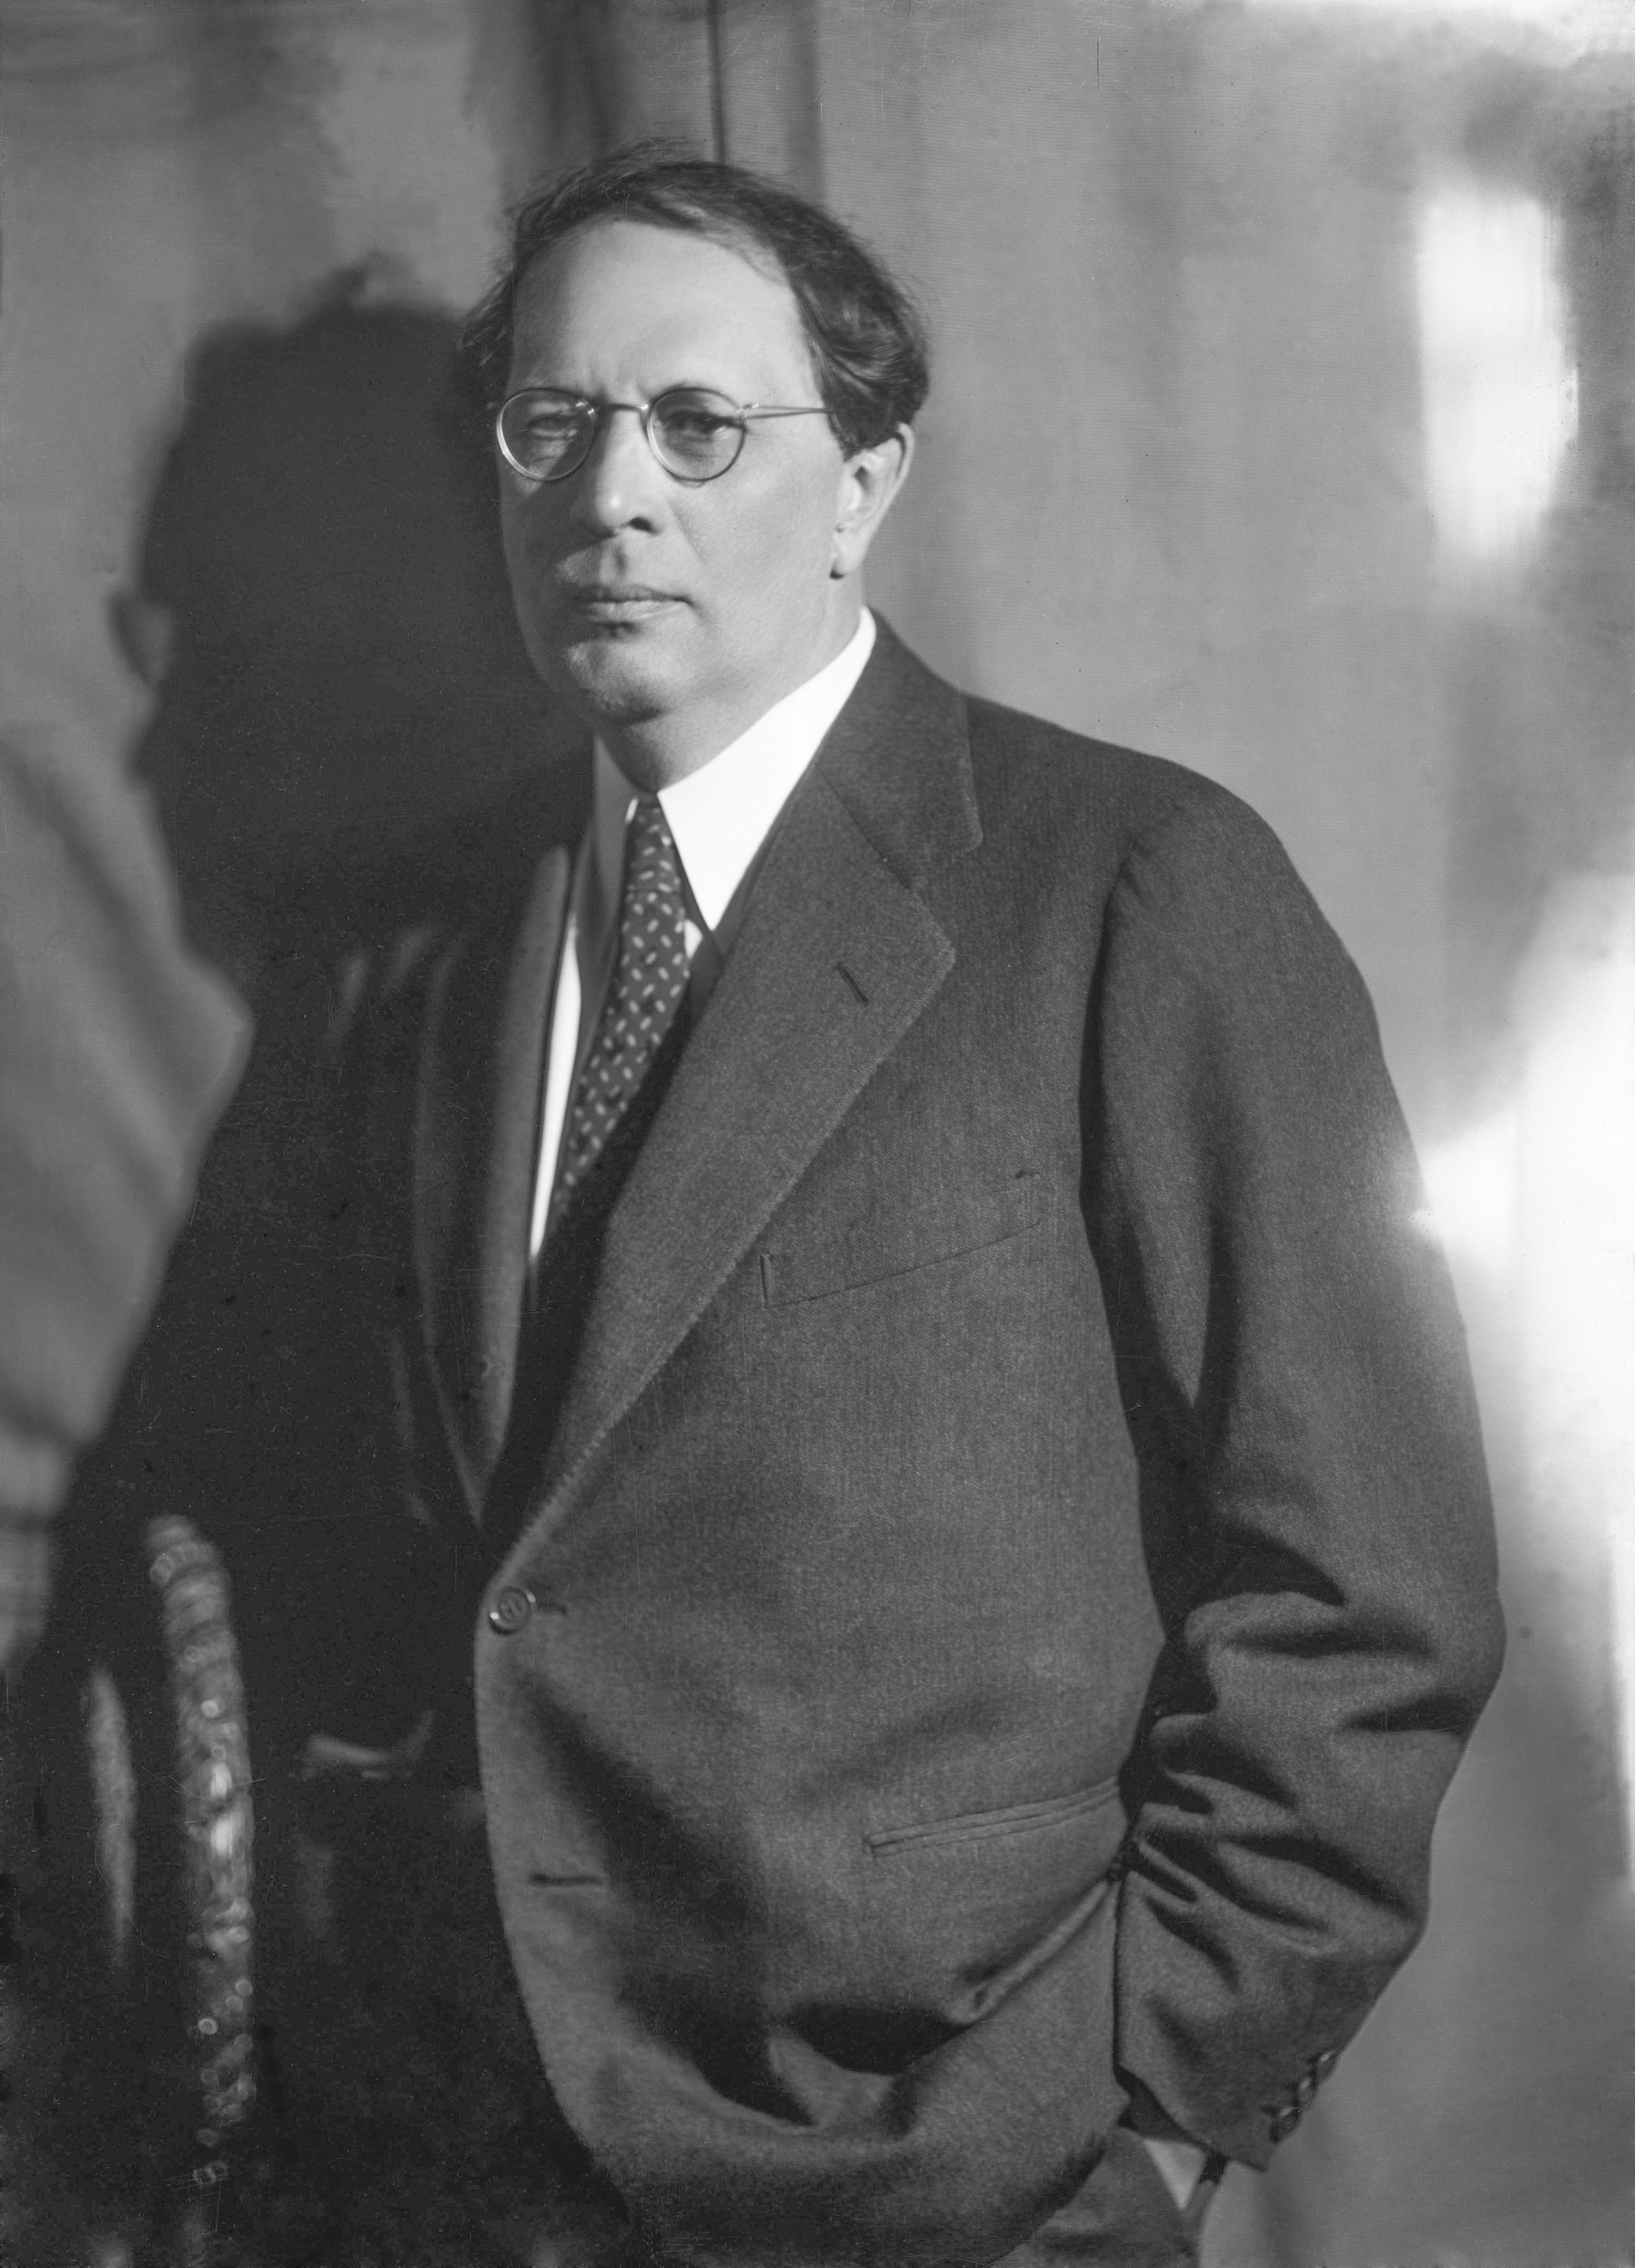
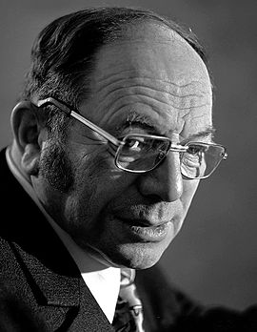
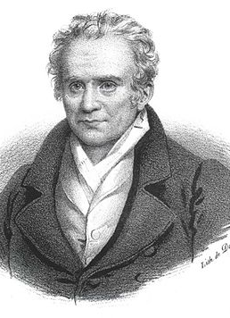
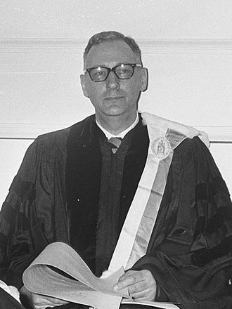
meet the great minds
A.N. Tolstoi
​Gaspard Monge
Leonid Kantorovich
tjalling koopmans

Slide 9
Uses
Determine low cost location
Minimize shipping cost
Find minimum cost production schedule
Military distribution system
To allocate military resources efficiently
Entertainment industry
For example, determining the tour od singers and perfromers

Slide 10

summary
The transportation problem is one of the most frequently encountered applications in real life situations. The transportation problem indicates the amount of consignment to be transported from various origins to different destinations so that the total transportation cost is minimized without violating the availability constraints and the requirement constraints.

Slide 11
References
Application of transportation problems in real life (article)
Transportation Theory (Wikipedia)
Comparison of transportation problem in operational research
Linear Programming and Game theory by Ghosh & Chakravarty

Slide 12
thank you
Huzefa Ayub
Roll-203034-11-0103
BSc Mathematics(Hons)
Semester 5

